Slide 1
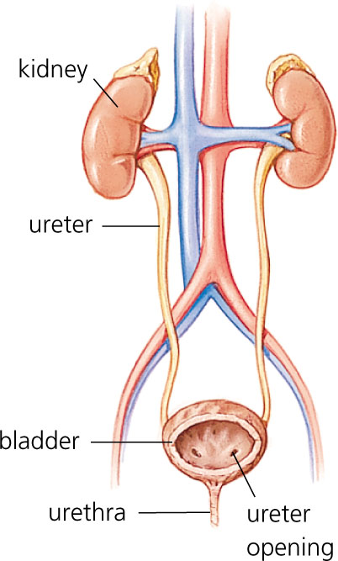
11.0 Animal Health Needs 11.8 Describing the Urinary System

Slide 2
Parts of the Urinary System

Slide 3
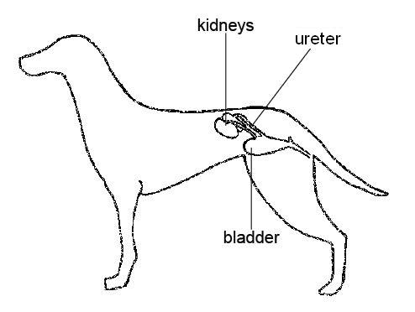
Dog Urinary System (Side View)

Slide 4
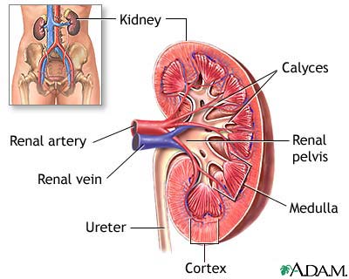
Function of the Kidneys
The blood enters the kidney via the renal artery.
The blood contains wastes from cell processes.
The blood flows into the kidney and through the basic functional units of the kidney called nephrons.

Slide 5
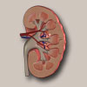
Function of the Nephrons
Nephrons are responsible for filtering out the wastes and leaving the essential parts of the blood in the blood stream.
The filtered blood then reenters the blood stream through the renal vein.

Slide 6
Functions of the Ureter, Urinary Bladder and Urethra
The ureter is a tube that carries waste (fluid) to the urinary bladder to be stored until urine can be discharged through the urethra.

